Slide 1

Gamified Loyalty: Turning Engagement into Rewards
Portal Pirates

Slide 2

InsightPlay
Small games. Big insights. Real rewards.

Slide 3

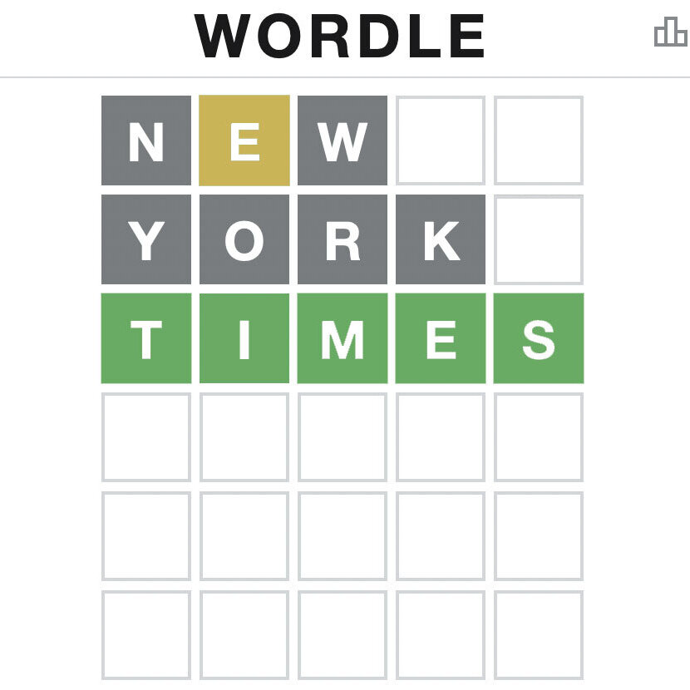
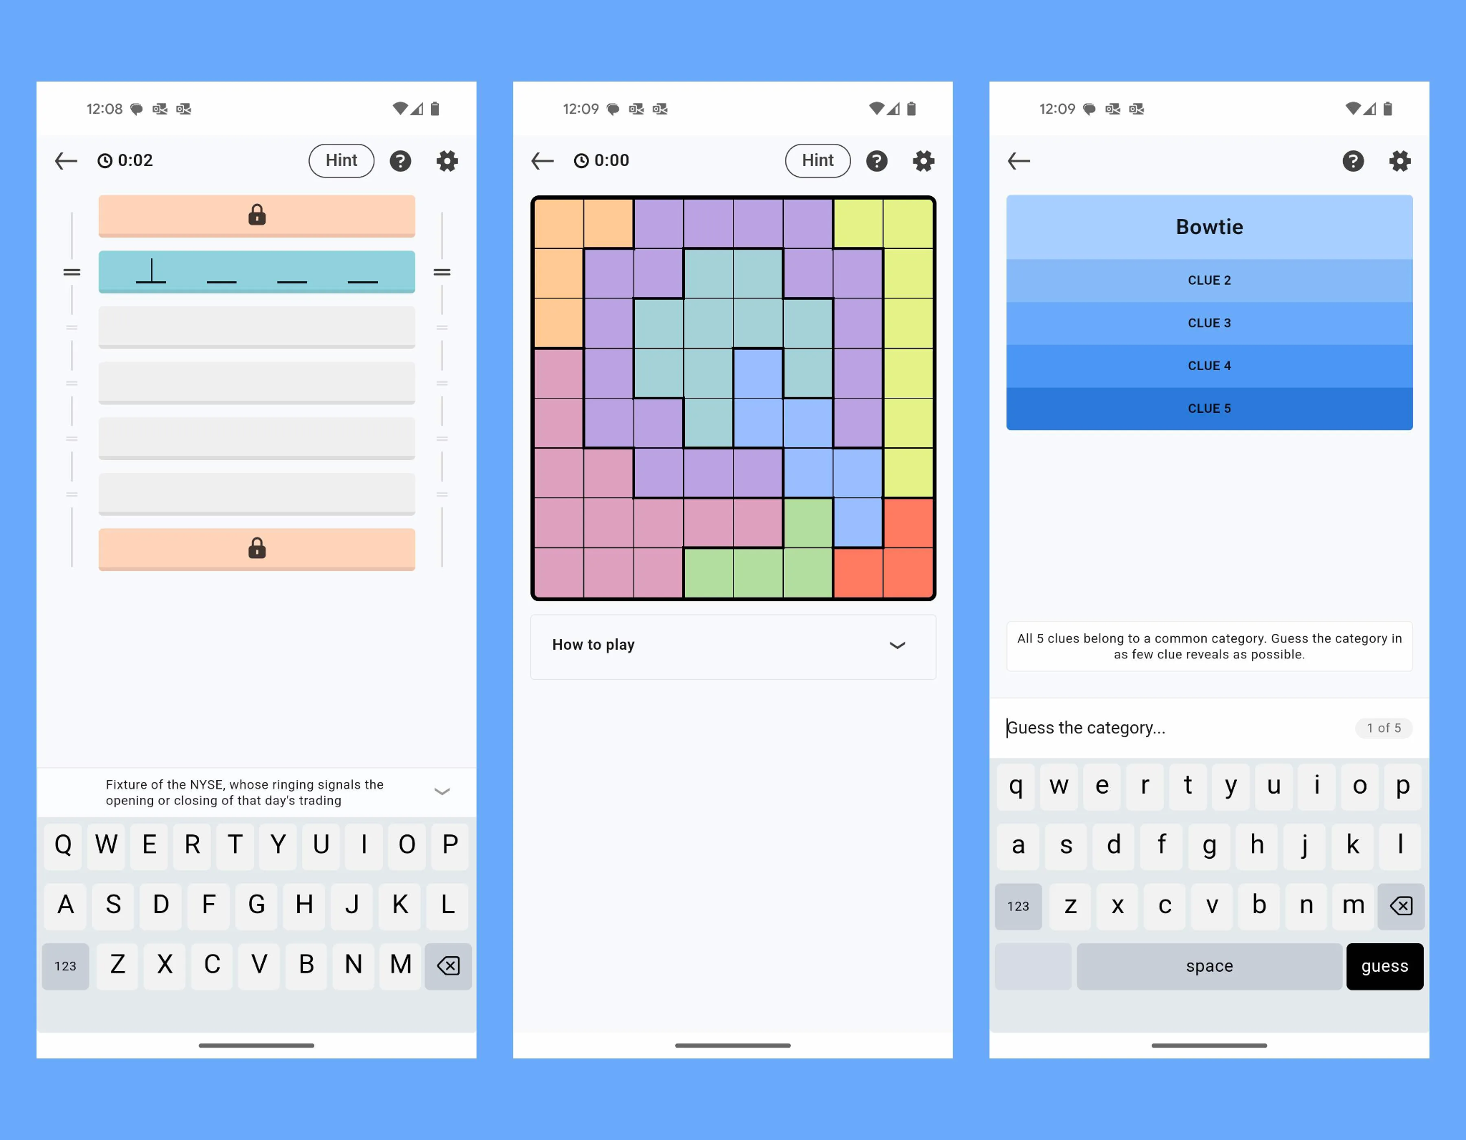
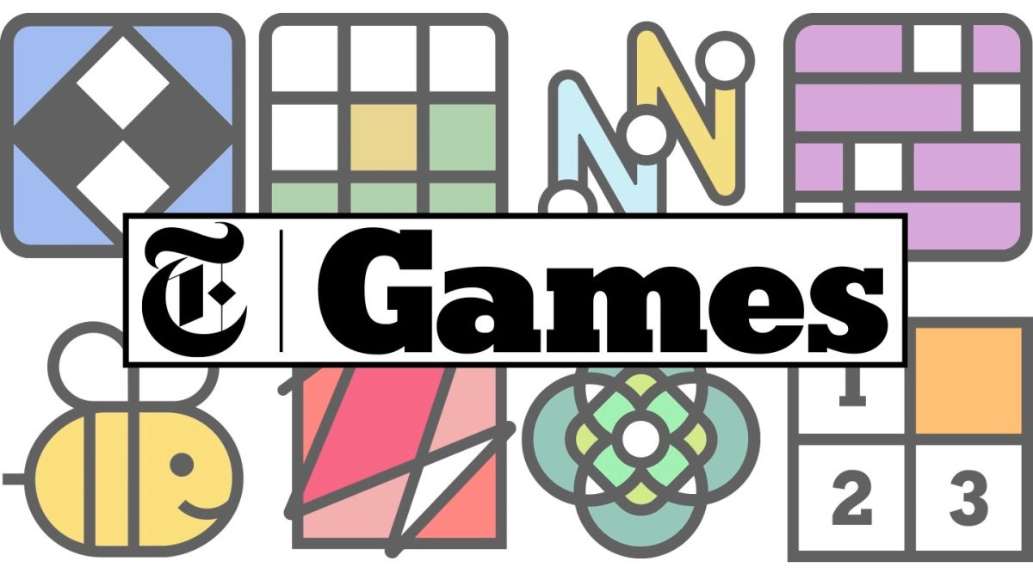

Slide 4
Daily minigames in the mobile app
Daily Games, Daily Awareness
Habit-Forming by Design
Making Finance Feel Good

Slide 5



Loyalty
Games & challenges
Rewards
Guess your spend
Higher or lower?
Supermarket Sweep
Price is Right
Wide spectrum
Personalised by AI
Set a savings goal
Streaks
Icons: Freepik - Spectrum (Gemology), Target Audience (Market Research), Fire (Nature)
Notes:
Streaks - keep them coming back

Slide 6


Enhancing awareness of financial habits
Real customer need
I don’t have enough money to make it to the end of the month.
Where did these unknown charges come from?
Drive a change in habits, through:
Awareness
Rewards
Everyday Banking
Credit Cards
Icons: Freepik - Nervous, Nervous (Human Relations and Emotions)

Slide 7
Demo

Slide 8





GCP
On-prem
Mobile
Hint Microservice
LLM
Suggested Rewards Microservice
Classifier
Core Banking
App
Points Microservice
Database

Slide 9



InsightPlay
Small games. Big insights. Real rewards.

Slide 10
Appendix

Slide 11
Rewards store
Preferential interest rates?? Mortgage rates?? We pay something towards their mortgage?
Discount rates
Interest-boost for a week/month in an account
Fee waivers
Rounding-up matching (by LBG - capped)
Free coffee etc.
2x points if you deposit £X
Donate to charity
BRONZE
SILVER
GOLD
PLATINUM
Notes:
Different kinds of rewards to represent our broad spectrum of customers. Personalised rewards based on customer behaviour, account types, other products that they use?

Slide 12
Problem statement
Design engaging, challenge-based experiences that encourage LBG customers to take meaningful actions and unlock more value from their relationship with the bank.
Using gamification, behavioural insights, and personalisations, create concepts that make loyalty more visible, rewarding, and interactive - helping customers understand, track, and earn rewards through clear goals, progress, and real-time feedback.

Slide 13
Problem statement
Aims
Design engaging, challenge-based experiences that encourage LBG customers to take meaningful actions and unlock more value from their relationship with the bank.
Using gamification, behavioural insights, and personalisations, create concepts that make loyalty more visible, rewarding, and interactive - helping customeunderstand, track, and earn rewards through clear goals, progress, and real-time feedback.

Slide 14




Notes:
Tech stack for this hack - react, gcp and lloyds themed styling - kotlin and swift

